Slide 1
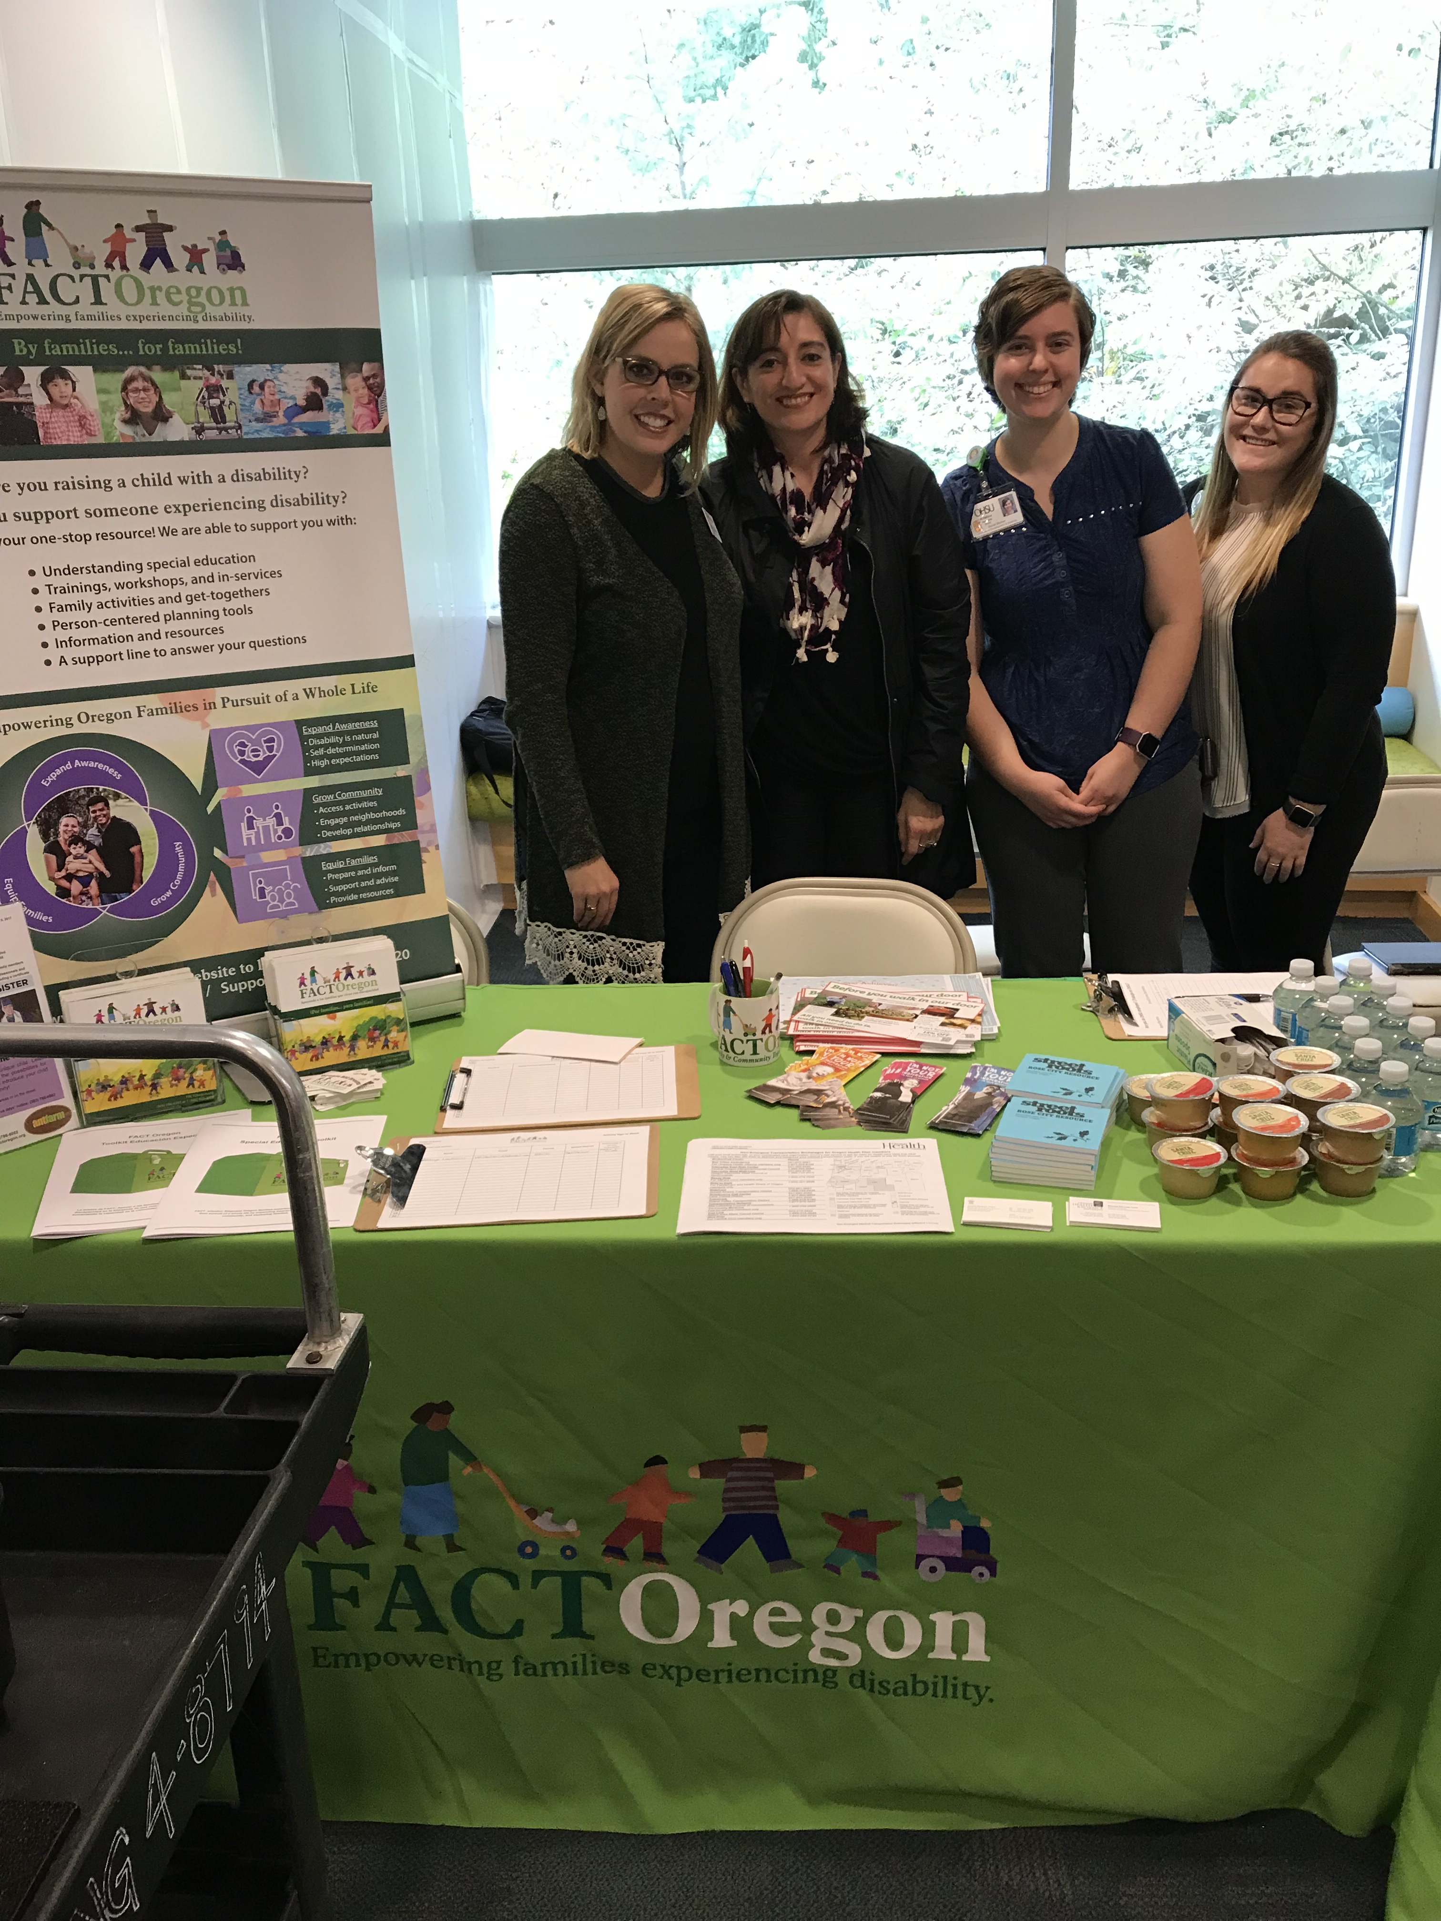
Maintaining the Change:
Moving Beyond Talking the Talk to Walking the Walk When it Comes to Diversity & Inclusion
Bethany Sloane, PT, DPT; Hannah Sanford-Keller, MS, CCC-SLP; Lindsay Sauvé, MPH
University Centers for Excellence in Developmental Disabilities (UCEDD)/Institute on Development and Disability (IDD)
Oregon Health & Science University, Portland, OR, USA
About our project
What did we learn?
The first and most important step of the project has been eliciting involvement and information from key stakeholders, including faculty members, families, and community members. We quickly realized we needed to include staff members from every level of the organization, especially trainees and interns. This project has helped advance necessary changes, but discussions about diversity and inclusion were needed prior to implementing policy changes. Our focus on improving communication and fostering conversation has helped create a sense of community and partnership within our organization.
The Institute on Development and Disability Diversity Task Force was established in 2015 as a way to address technical and adaptive changes in our healthcare institution needed to increase cultural and linguistic competency. We have adopted strategies to move beyond simply discussing healthcare equity and towards making sustainable changes.
Phase one: establishing the task force, creating a shared vision, and publishing a diversity statement.
Phase two: internal and external partnerships, strategic planning, and implementation of policy changes.
What are the issues?
“As a family member and as a person of color, being part of the diversity task force group has been a great way to advocate for families to improve their experiences in the clinic. This work is especially meaningful for those families who speak other languages, given that access to services is usually more difficult for them. We (the diversity task force) all bring different perspectives and experiences and this is essential when working to improve any system.”
-Paulina Larenas, Family Advocate, Task Force Member
What was challenging?
In Oregon, 32% of children with special healthcare needs are identified by their families as being non-Caucasian, and many come from rural areas (OCCYSHN, 2016). A lack of systematic policy around serving culturally and linguistically diverse families and patients contributes to inequity in access to healthcare services. Silos in work environment create additional communication challenges between trainees, faculty, administrators, families and patients.
After creating the Task Force, we faced difficulty developing a presence within the IDD and communicating our goals with the larger IDD community. We quickly realized we needed buy-in from leaders at our institution to help us advocate for financial support of projects. However, changing policy and challenging current systems often led to pushback from leadership. In addition, our enthusiasm for identified projects resulted in policy-level discussions without first eliciting information from diverse populations. We continue to involve families in the communities we serve in ongoing discussions and work towards improving community partnerships to guide our work.
What did we do?
How can this information help you?
1 cohesive IDD Diversity Action Plan
27 members representing all sub-groups of the IDD
6 trainings provided to students, employees on diversity and disability
1 summer intern
Lunch and Learn series with community partners
Diversity book drive
1 established policy on translating clinic reports
Diversity corner of IDD Digest
Partnership with University Center for Diversity and Inclusion
2 graduates of the Georgetown Leadership Academy
Feel empowered to advocate for real change across institutions to help decrease healthcare inequities and better support children with disabilities
IDD Diversity & Inclusion Task Force Diversity Statement:
As compassionate leaders in healthcare, we strive to provide innovative and comprehensive services in a welcoming environment. The diversity of life is valued here, and we are committed to making inclusion a priority so everyone feels comfortable, valued, and respected.
Utilize our national network to share strategies, successes, and challenges with others who are pushing for similar changes across settings
We can all be leaders in this work regardless of formal title or job description
Presented at the 2017 Association of University Centers on Disabilities Conference, Washington, DC

